Slide 1

Zero Effort Spring: An intro to Spring Boot
Scott Deeg, Sr. Field Engineer, Pivotal
sdeeg@gopivotal.com

Slide 2
Agenda
Goal: Introduce developers to Spring Boot, an opinionated way to rapidly build production grade Spring applications quickly and with minimal fuss.
Introduction to Spring Boot
Where it fits in the Spring eco system
Goals, high level features, etc.
Demo: Quick Start
Behind the scenes
More demos, more Boot
End bits (links and such)
ToDo: Adding new features to Boot

Slide 3
What is Pivotal?
Vmware and EMC spin out
vFabric from vmware
Greenplum MPP DB and Hadoop from EMC
Agile development acquisitions Pivotal Labs and Xtreme Labs
Paul Maritz CEO
Former CEO vmware.
Custodian of various OSS projects including Spring
and RabbitMQ, Redis, CloudFondry, Groovy/Grails, …
Commercial interests in Big/Fast Data, PaaS, Enterprise tooling
Spring is an enabling technology

Slide 4
What’s New in Spring

Slide 5
Spring vs JEE … ready … FIGHT!
NOT going there! :-)

Slide 6

Spring 4.0 Highlights
Java/EE
Java 8
JSR-310 Date/Time API
JSR-236 Concurrency Utils
JSR-356 WebSocket
Servlet 3.1
Bean Validation 1.1
JPA 2.1
JTA 1.2
JMS 2.0
Spring iO
(Large feature set, and getting larger)

Slide 7



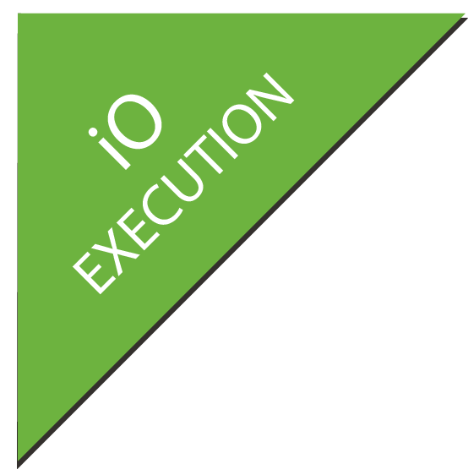















Big Spring Diagram with Boot
XD
BOOT
GRAILS
Stream, Taps, Jobs
Bootable, Minimal, Ops-Ready
Full-stack, Web
INTEGRATION
BATCH
BIG DATA
WEB
Channels, Adapters, Filters, Transformers
Jobs, Steps, Readers, Writers
Ingestion, Export, Orchestration, Hadoop
Controllers, REST, WebSocket
DATA
RELATIONAL
NON-RELATIONAL
CORE
FRAMEWORK
SECURITY
GROOVY
REACTOR

Slide 8
Spring Boot
Intro

Slide 9
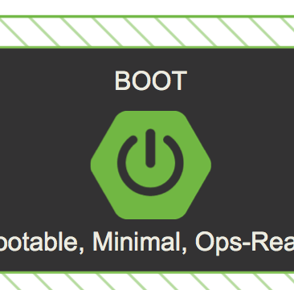
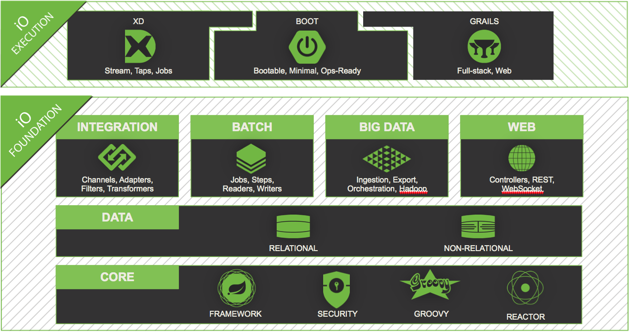
Introduction to Spring Boot
A tool for getting started very quickly with Spring applications
Focuses attention at a single point
Control a large collection of spring-* projects
Common non-functional requirements for “real world” applications
Exposes a lot of useful features by default
Gets out of the way quickly when you need it to
v0.5.0.Mx

Slide 10
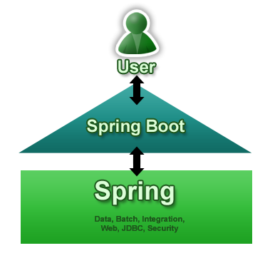
Goals
Provide a radically faster and widely accessible getting started experience
Be opinionated out of the box, but get out of the way quickly as requirements start to diverge from the defaults
Provide a range of non-functional features that are common to large classes of projects (e.g. embedded servers, security, metrics, health checks, externalized configuration)
Absolutely no code generation and no requirement for XML configuration
V0.5.0M4
(Question: What about Roo?)

Slide 11
Getting Started REALLY Quickly
app.groovy:
@Controller
class ThisWillActuallyRun
{
@RequestMapping("/")
@ResponseBody
String home() { return "Hello World!" }
}
then
$ spring run app.groovy

Slide 12
Demo
Quick Start

Slide 13
What Just Happened?
SpringApplication: convenient way to write a main() method that loads a Spring context
@EnableAutoConfiguration: optional annotation that adds stuff to your context, including...
EmbeddedServletContainerFactory: added to your context if a server is available on the classpath
CommandLineRunner: a hook to run application-specific code after the context is created
JarLauncher was added to the JAR file
It’s beginning to look a lot like Java …

Slide 14
Demo
Doing it in Java

Slide 15
Spring Boot Modules
Spring Boot - main library supporting the other parts of Spring Boot
Spring Boot Autoconfigure - single @EnableAutoConfiguration annotation creates a whole Spring context
Spring Boot Starters - a set of convenient dependency descriptors that you can include in your application.
Spring Boot CLI - compiles and runs Groovy source as a Spring application
Spring Boot Actuator - common non-functional features that make an app instantly deployable and supportable in production
Spring Boot Tools - for building and executing self-contained JAR and WAR archives
Spring Boot Samples - a wide range of sample apps

Slide 16


Spring Boot Modules
CLI
Starters
Autoconfigure
Boot
Actuator
Tools
Samples

Slide 17
Binding to Command Line Arguments
SpringApplication binds its own bean properties to command line arguments, and then adds them to the Spring Environment, e.g.
$ java -jar target/*.jar --server.port=9000
Externalize Config
Just put application.properties in your classpath, e.g.
application.properties
server.port: 9000
Use YAML (if you must)
Just put application.yml in your classpath
Both properties and YAML add entries with period-separated paths to the Spring Environment.

Slide 18
Demo
Change the app behavior by changing parameters

Slide 19
Add a Thymeleaf UI
Add Thymeleaf to the classpath and see it render a view
Spring Boot Autoconfigure has added all the boilerplate stuff
Common configuration options via spring.thymeleaf.*, e.g. spring.thymeleaf.prefix:classpath:/templates/ (location of templates) spring.tjymeleaf.cache:true (set to false to reload templates when changed)
Extend and override: add Thymeleaf IDialect beans add thymeleafViewResolver add SpringTemplateEngine add defaultTemplateResolver

Slide 20
Demo
Oooo …. pretty

Slide 21
Currently Available Auto-configured Behavior
Embedded servlet container (Tomcat or Jetty) DataSource and JdbcTemplate JPA Spring Data JPA (scan for repositories) Thymeleaf
Batch processing Reactor for events and async processing Actuator features (Security, Audit, Metrics, Trace)

Slide 22
The Actuator
Adds common non-functional features to your application and exposes MVC endpoints to interact with them.
Security Secure endpoints: /metrics, /health, /trace, /dump,
/shutdown, /beans Audit /info
If embedded in a web app or web service can use the same port or a different one (and a different network interface).

Slide 23
Demo
Show me that!

Slide 24
Other
Security
Use Actuator
Can also use Spring Security
Logging
Spring Boot provides default configuration files for 3 common logging frameworks: logback, log4j and java.util.logging
Starters (and Samples) use logback External configuration and classpath influence runtime behaviour LoggingApplicationContextInitializer sets it all up

Slide 25
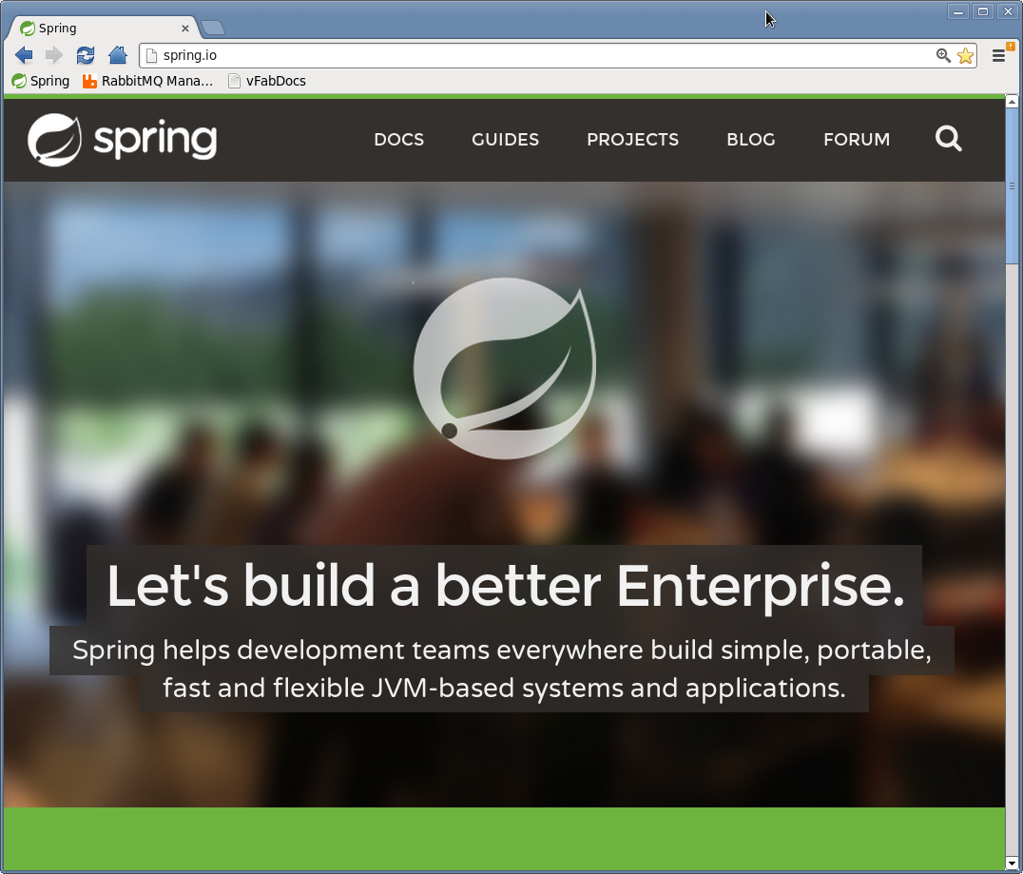
Does Anybody Use This For Real?
We do
Spring Boot app
Thymeleaf UI
Hosted on Cloud Foundry

Slide 26
Links
Spring
https://projects.spring.io/spring-boot
https://github.com/spring-projects/spring-boot (on Github)
http://spring.io/blog/2013/09/20/contributing-to-spring-boot-with-a-pull-request
Random Boot Blogs
http://fbflex.wordpress.com/2013/10/01/a-spring-boot-generator-for-yeoman

Slide 27
Thanks!

Slide 28
Learn More. Stay Connected.
Download now:
springsource.org/spring-tool-suite-download (eclipse plugin)
springsource.org/download/community (zip)
springsource.org/spring-framework#maven (maven)
Monthly Newsletter: springsource.org/news-events
Twitter: twitter.com/springsource
YouTube: youtube.com/user/SpringSourceDev
RSS Feed: feeds.feedburner.com/springsource/OEVE
LinkedIn: springsource.org/linkedin

